Slide 1

E-Commerce Data Vault
Rayan Hassan, Soumyae Tyagi
DS5110 – Intro to Data Management Section 04

Slide 2
Introduction
Goals
Design a robust and scalable data warehousing solution that integrates both user reviews and product metadata
Create a ChatBot that can answer all types of questions about a given product

Slide 3
Literature Review
Real-Time data processing
hybrid architectures
Research
Use of ETL (Extract, Transform, Load) pipelines
AI tools
Interactive UI/Dashboards

Slide 4
Methodology
Data Selection
Data Pipeline/Preprocessing
Data Visualization
ChatBot
Download Dataset
Connect to Google Cloud Storage
Convert json files to csv
Connect to PostrgeSQL database
Create database using GC CLI
Clean data and create tables
User Reviews
Product Metadata
Create LLM RAG-based Chatbot
Create Dashboards
Review Trends
Product Metadata Visualization

Slide 5
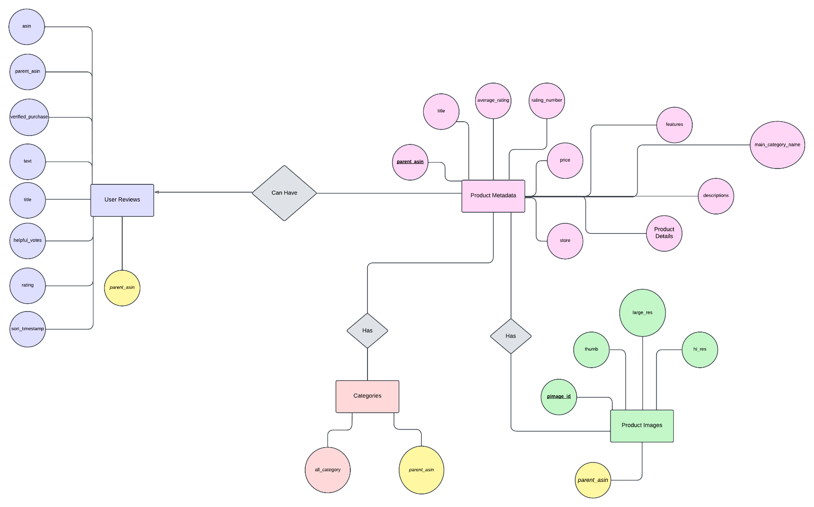
ERD

Slide 6
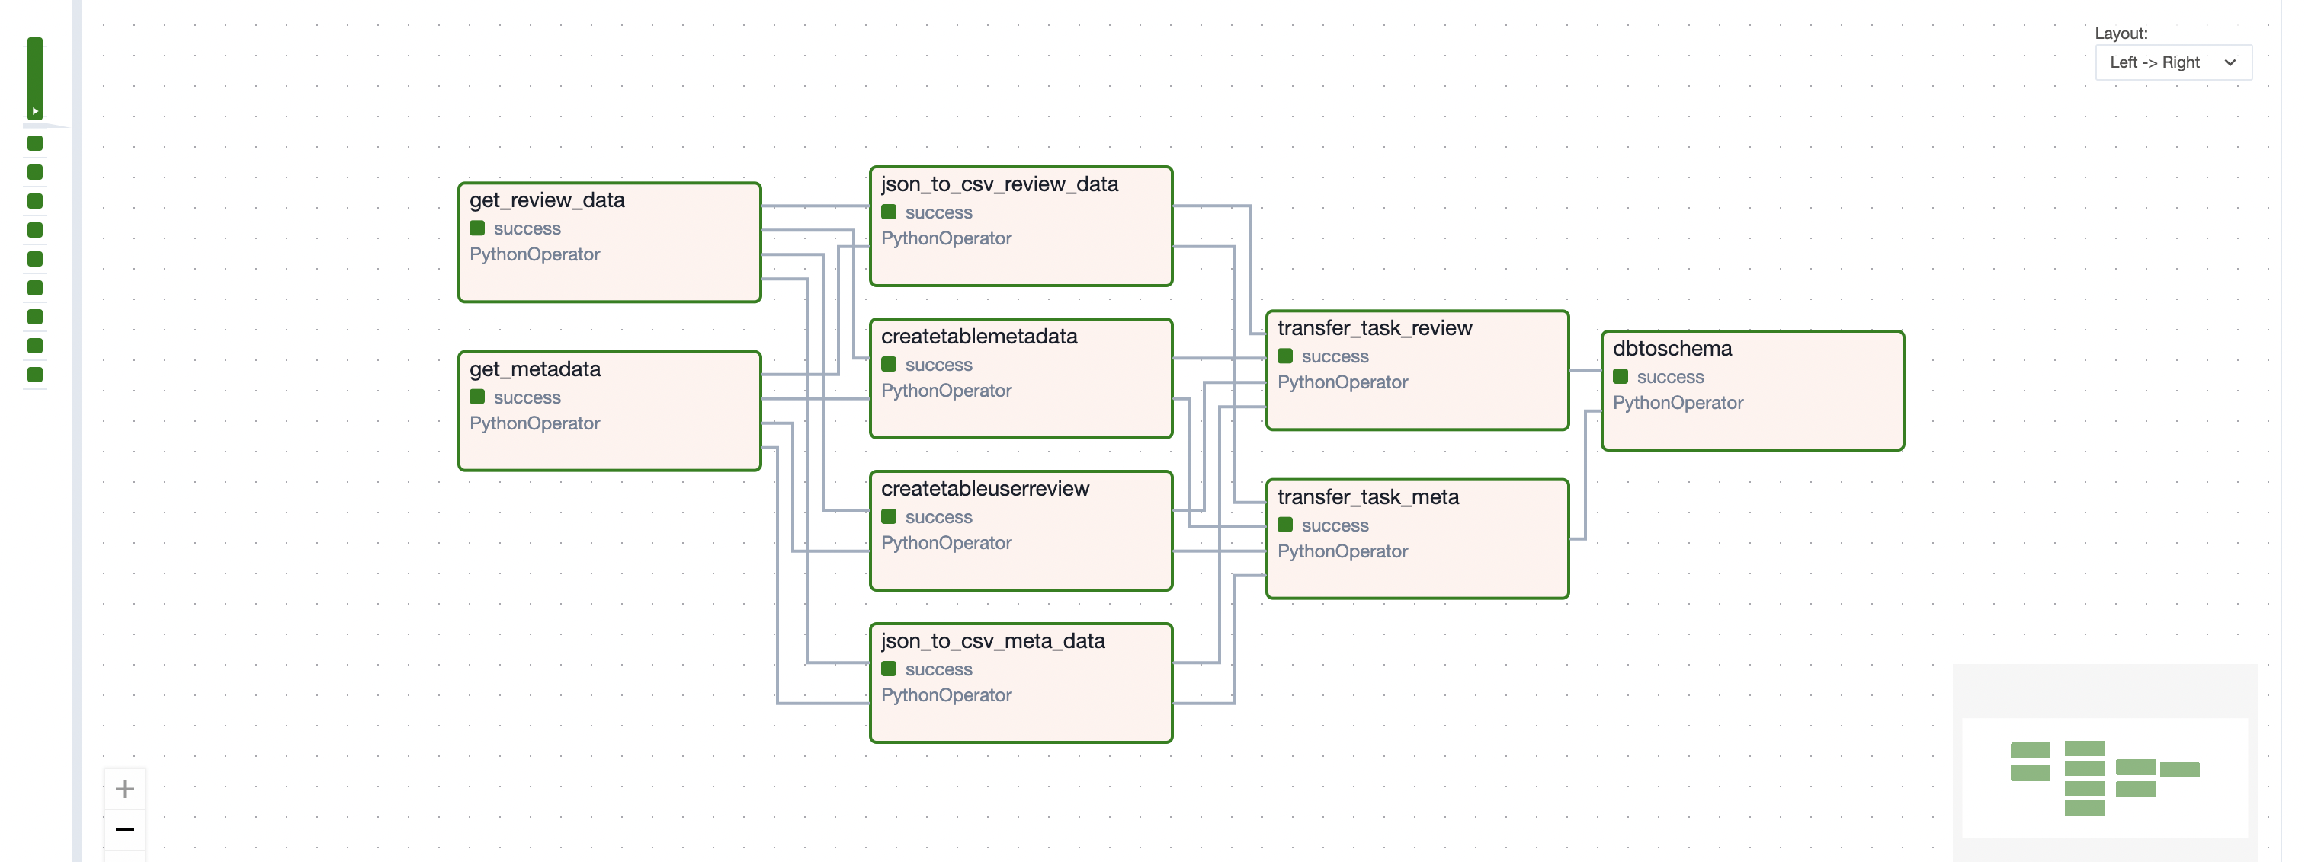
Data Pipeline for Adding/Uploading Data (Apache Airflow)

Slide 7
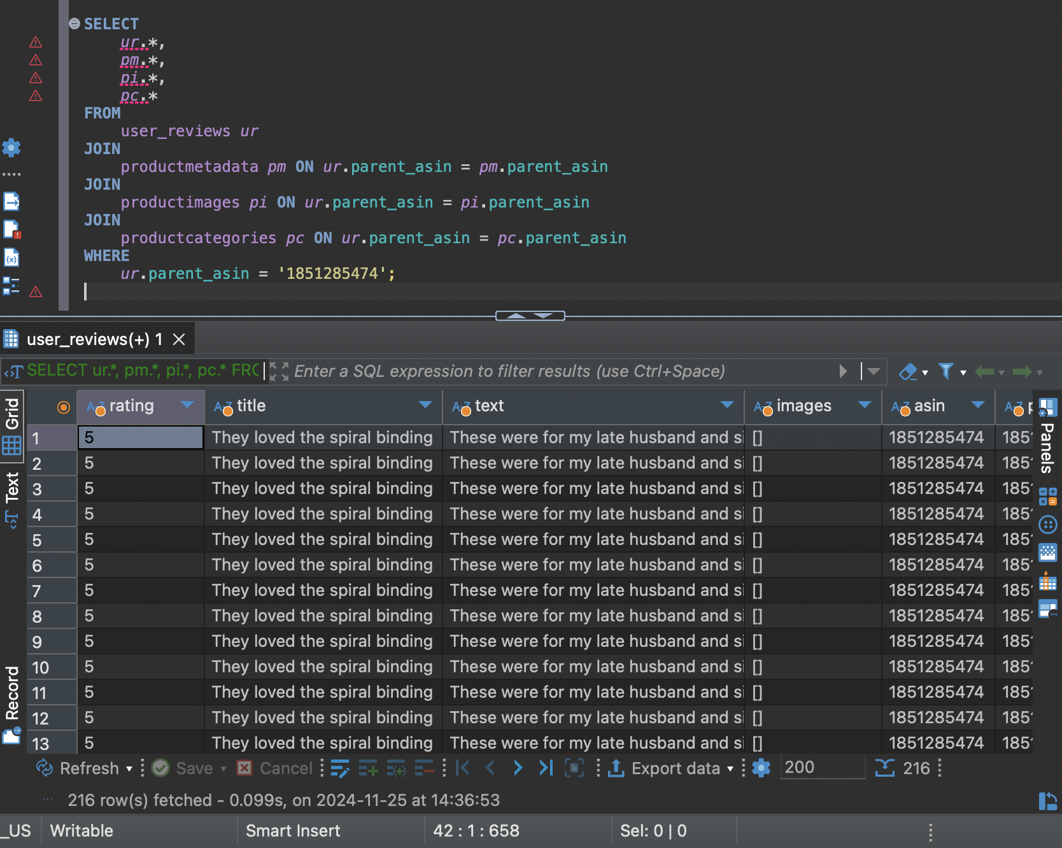
SQL Queries – Retrieving Data

Slide 8
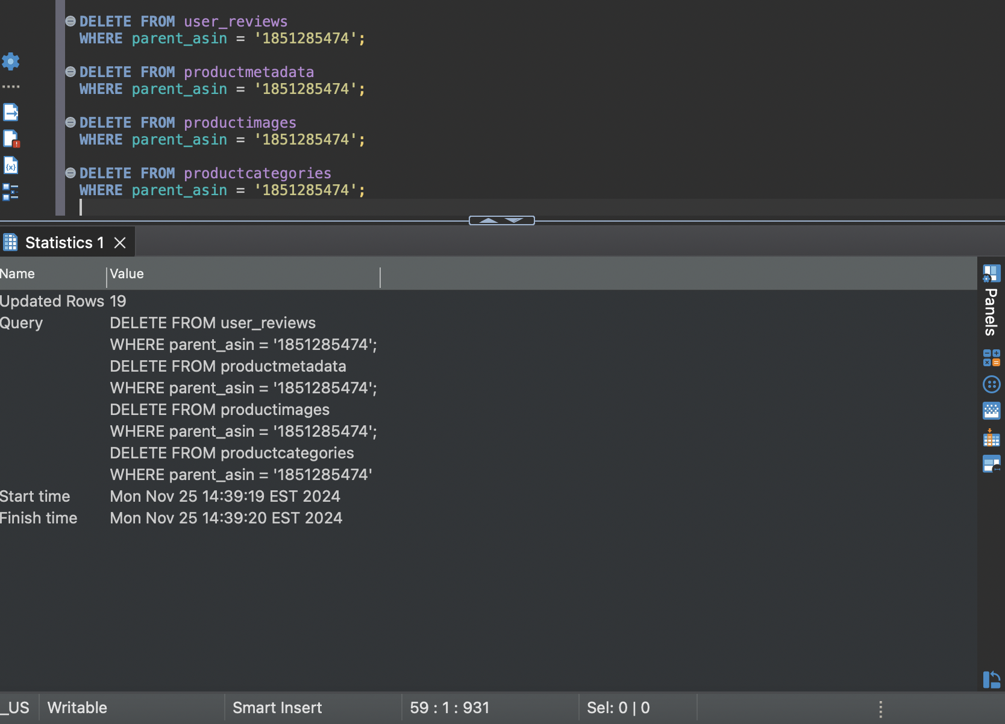
SQL Queries – Removing Data

Slide 9
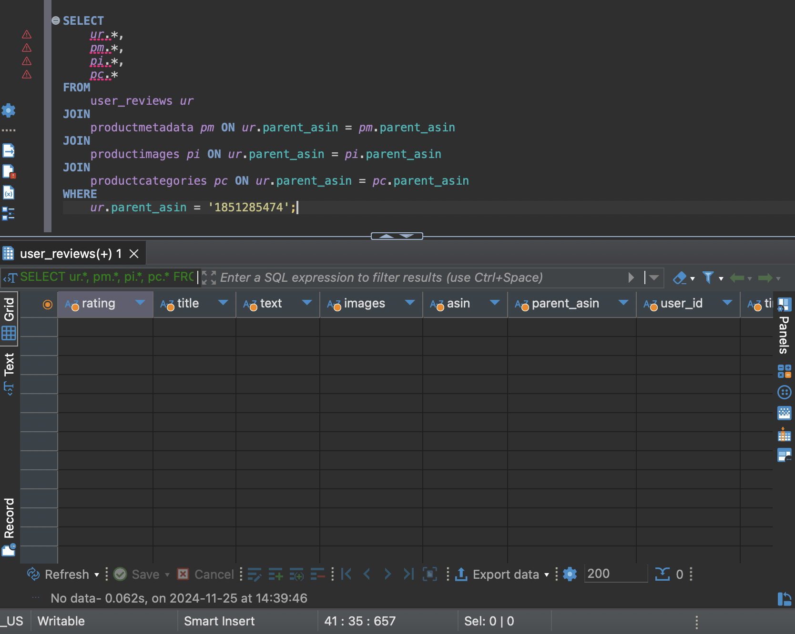
SQL Queries – Retrieving Data After Removal

Slide 10
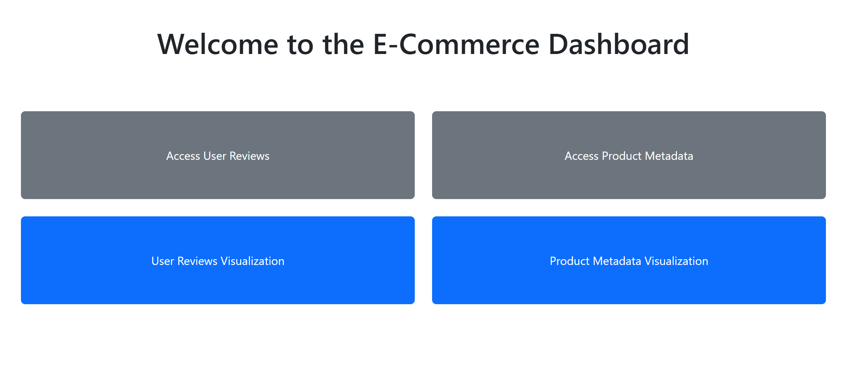
Dashboards – Control Panel

Slide 11
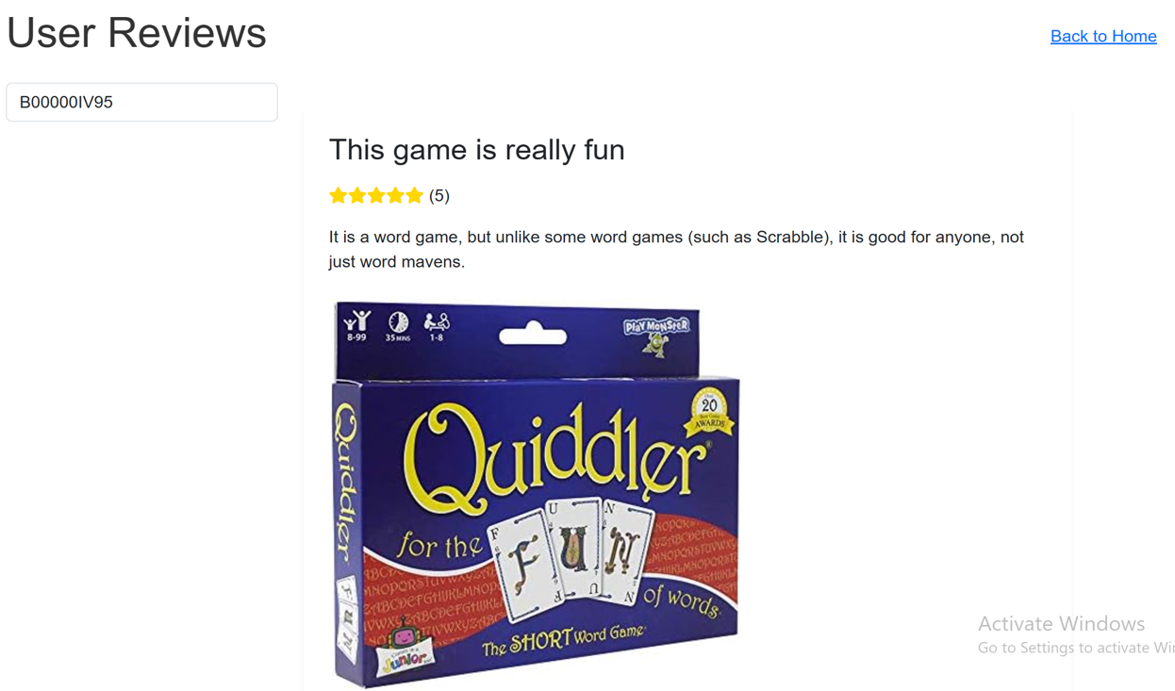
Dashboards – Access User Reviews

Slide 12
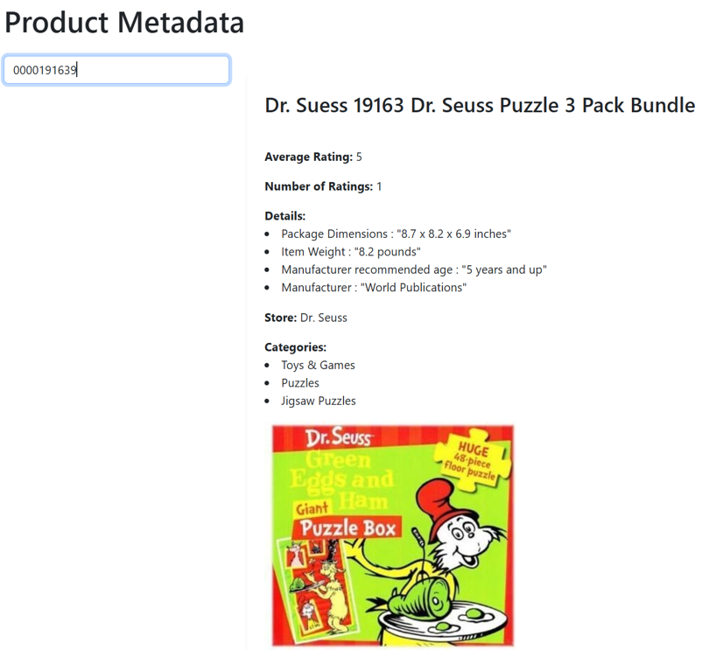
Dashboards – Access Product Metadata

Slide 13
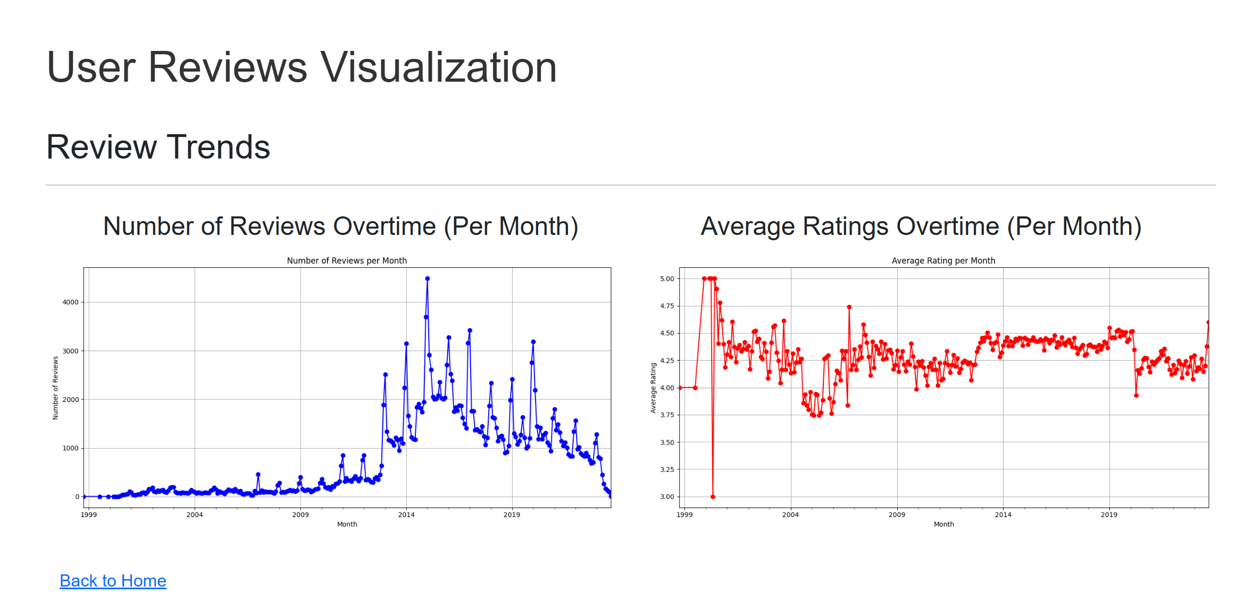
Dashboards – User Reviews Visualization

Slide 14
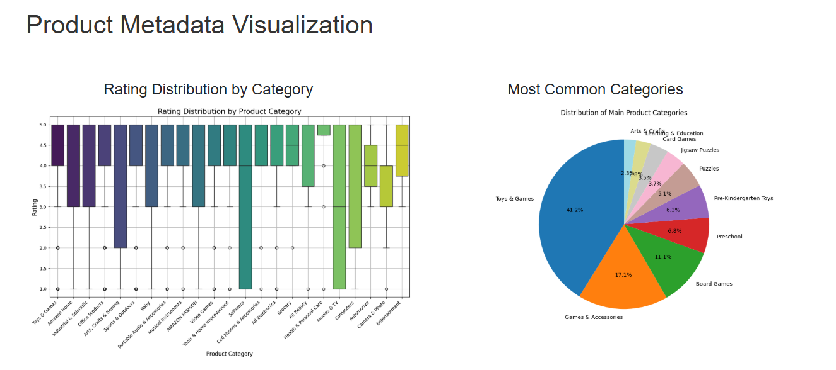
Dashboards – Product Metadata Visualization (1)

Slide 15
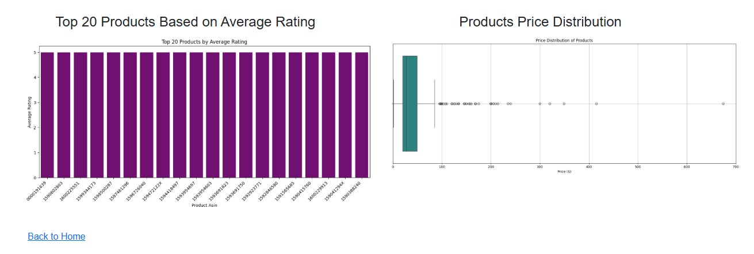
Dashboards – Product Metadata Visualization (2)

Slide 16

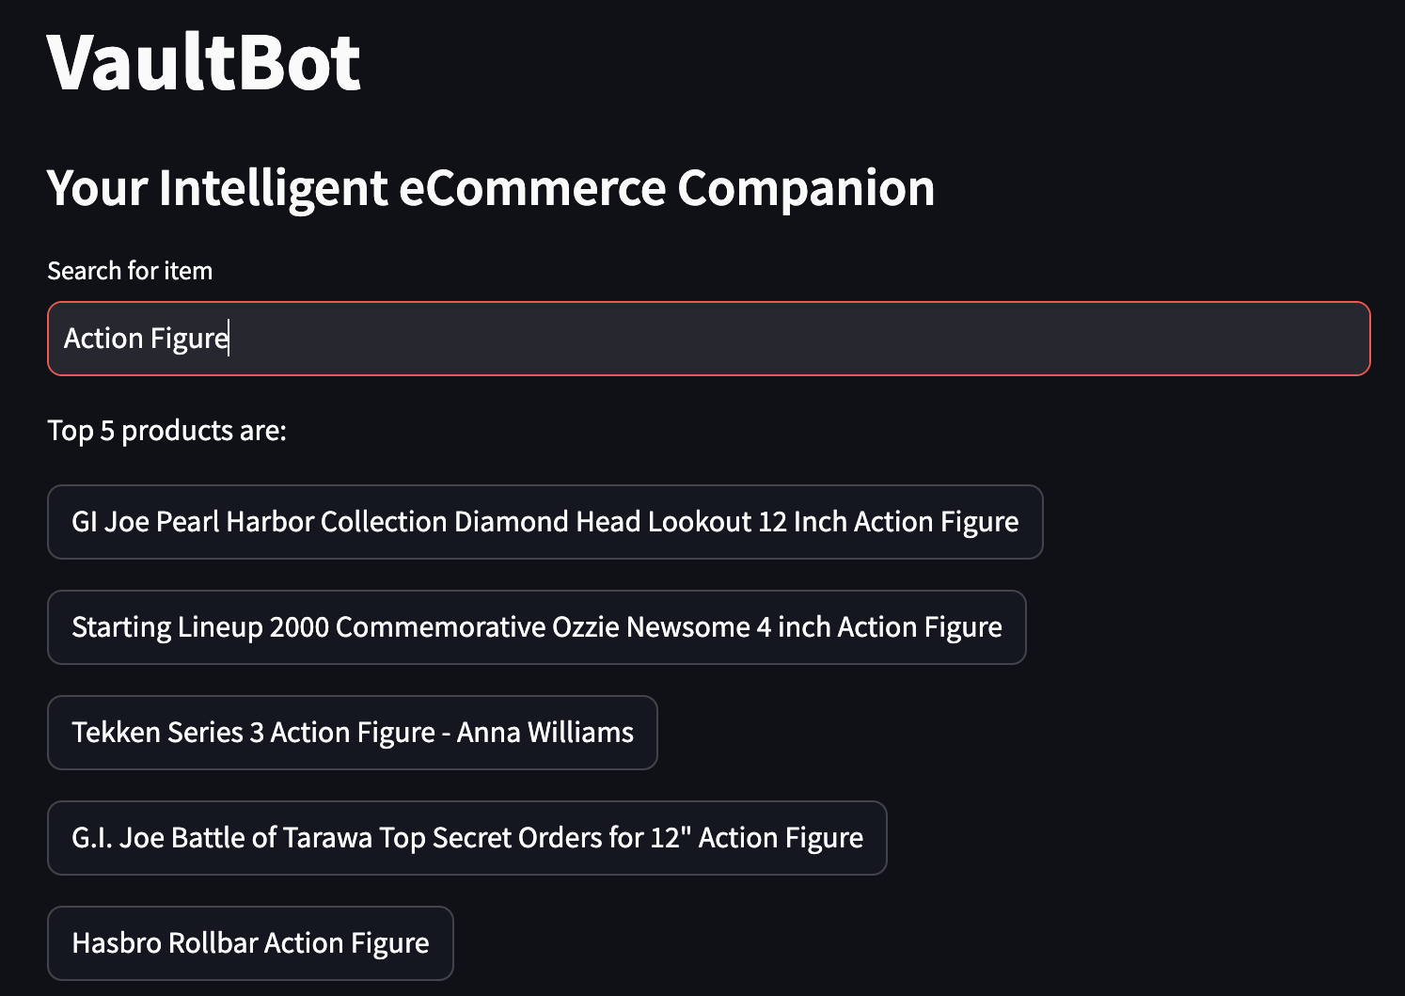
ChatBot

Slide 17
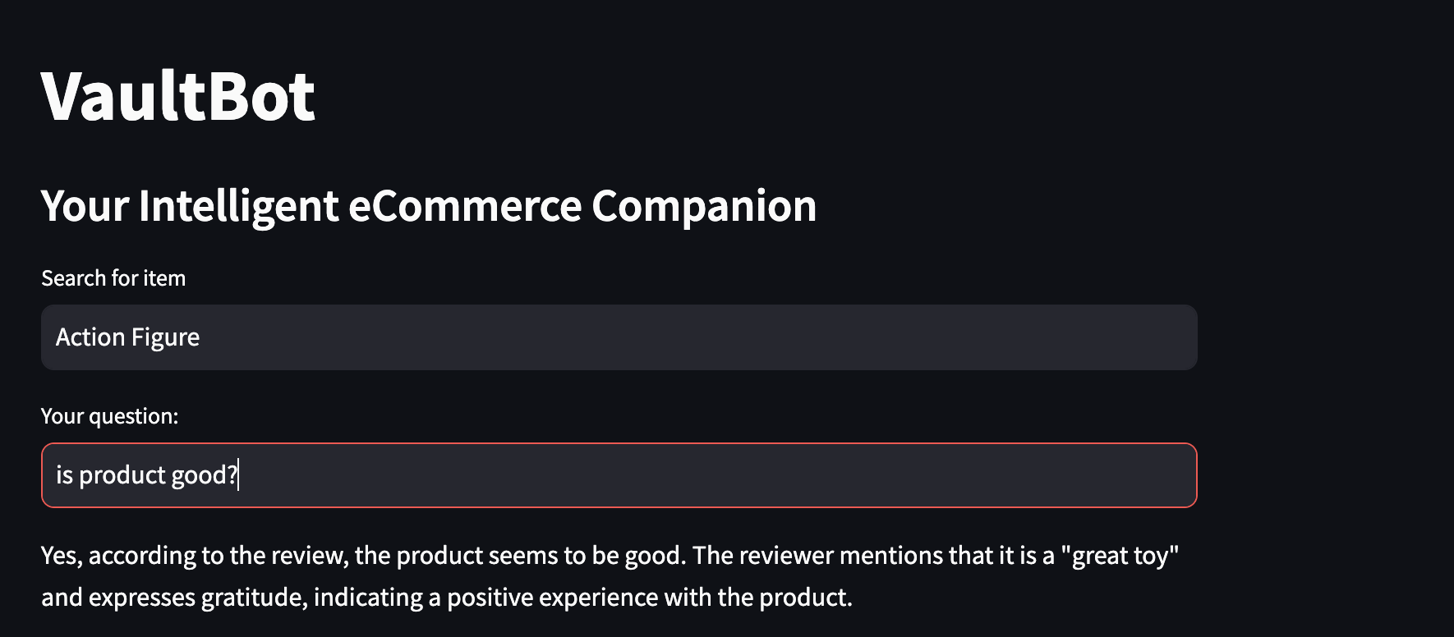
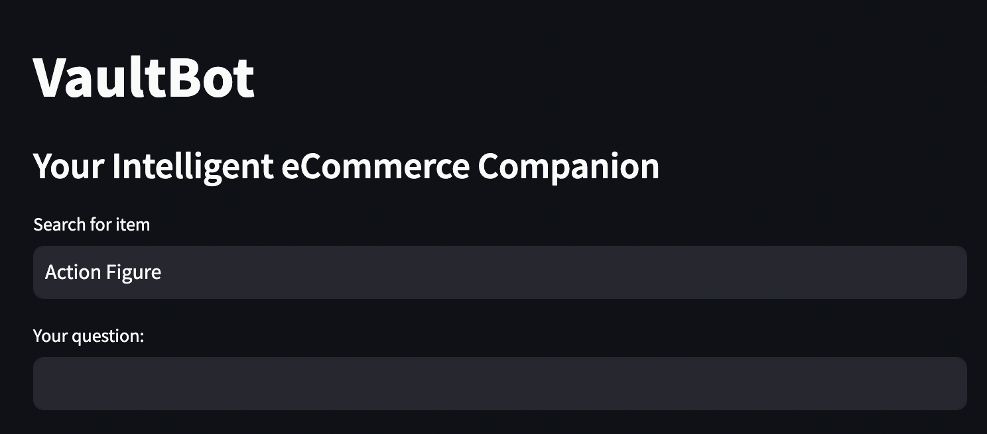
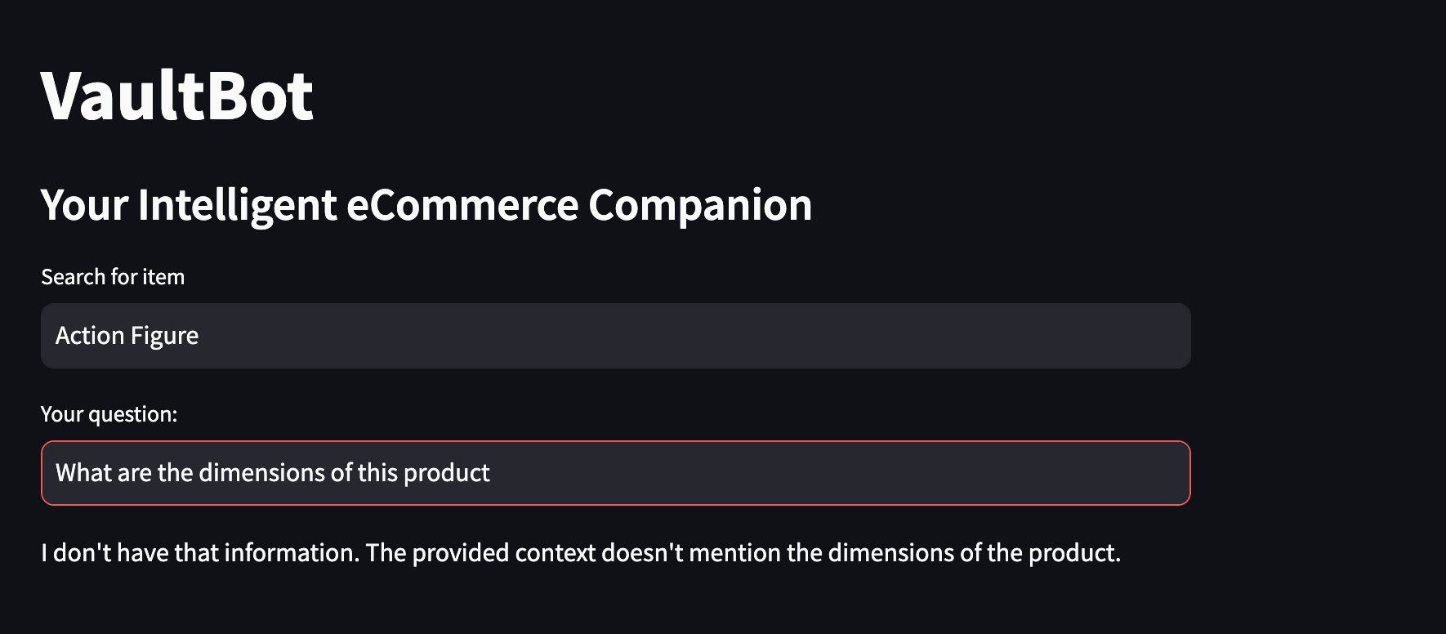
ChatBot

Slide 18
Discussion
Challenges
Limitations
Maintaining real-time data processing
Dealing with large amount of data
Creation of ChatBot to enhance user interaction
Large amount of Data and limited GCP credit
Visualization was done on a sample of the actual data
Time restrictions

Slide 19

Conclusion
Warehouse solution that integrates structured and unstructured data
Future Work
Real-time interactivity with Data Dashboards
Unlimited GCP credits
Dynamic Visualization for DataVault
Use of automated ETL processes
Supports basic SQL queries like adding and removing product data
Valuable data visualization techniques and interactive Dashboards
Creation of a ChatBot to help answer user questions about products

Slide 20
References
• Hou, Yupeng, Li, Jiacheng, He, Zhankui, Yan, An, Chen, Xiusi, and McAuley,Julian. ”Bridging Language and Items for Retrieval and Recommendation.” arXivpreprint arXiv:2403.03952 (2024)
• Chen, H., Chiang, R. H., & Storey, V. C. (2012). Business intelligence and analytics:From big data to big impact. MIS Quarterly, 36(4), 1165–1188. https://doi.org/10.2307/41703503
• Faisal, M. I., Hossain, M. A., & Rahman, M. S. (2020). Automated ETL pipelinefor data integration in cloud data warehousing. Journal of Cloud Computing: Ad-vances, Systems and Applications, 9(1), 34-47. https://doi.org/10.1186/s13677-020-00214-w
• Stonebraker, M., C¸ etintemel, U., & Zdonik, S. (2018). The design of modern datamanagement systems. ACM Computing Surveys, 50(2), 1-41. https://doi.org/10.1145/3184738

Slide 21
Any Questions

